Slide 1
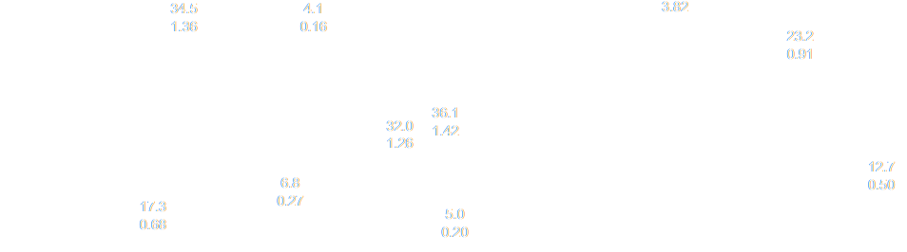
SEMTM0043 Robotics Science & Systems
TB2, AY 2025-2026
Unit Director: Paul O’Dowd (paul.odowd@bristol.ac.uk)

Slide 2
What is…
…Robotics Science?
…Robotics Systems?

Slide 3
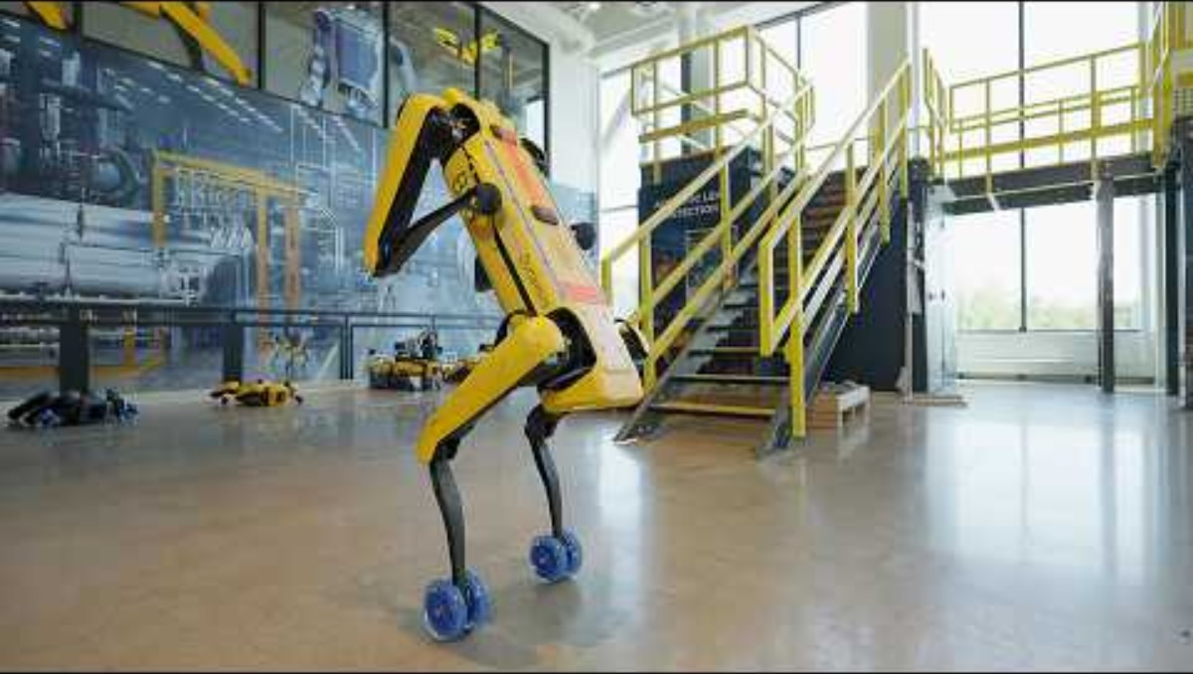
Robotics Science & Systems?

Slide 4
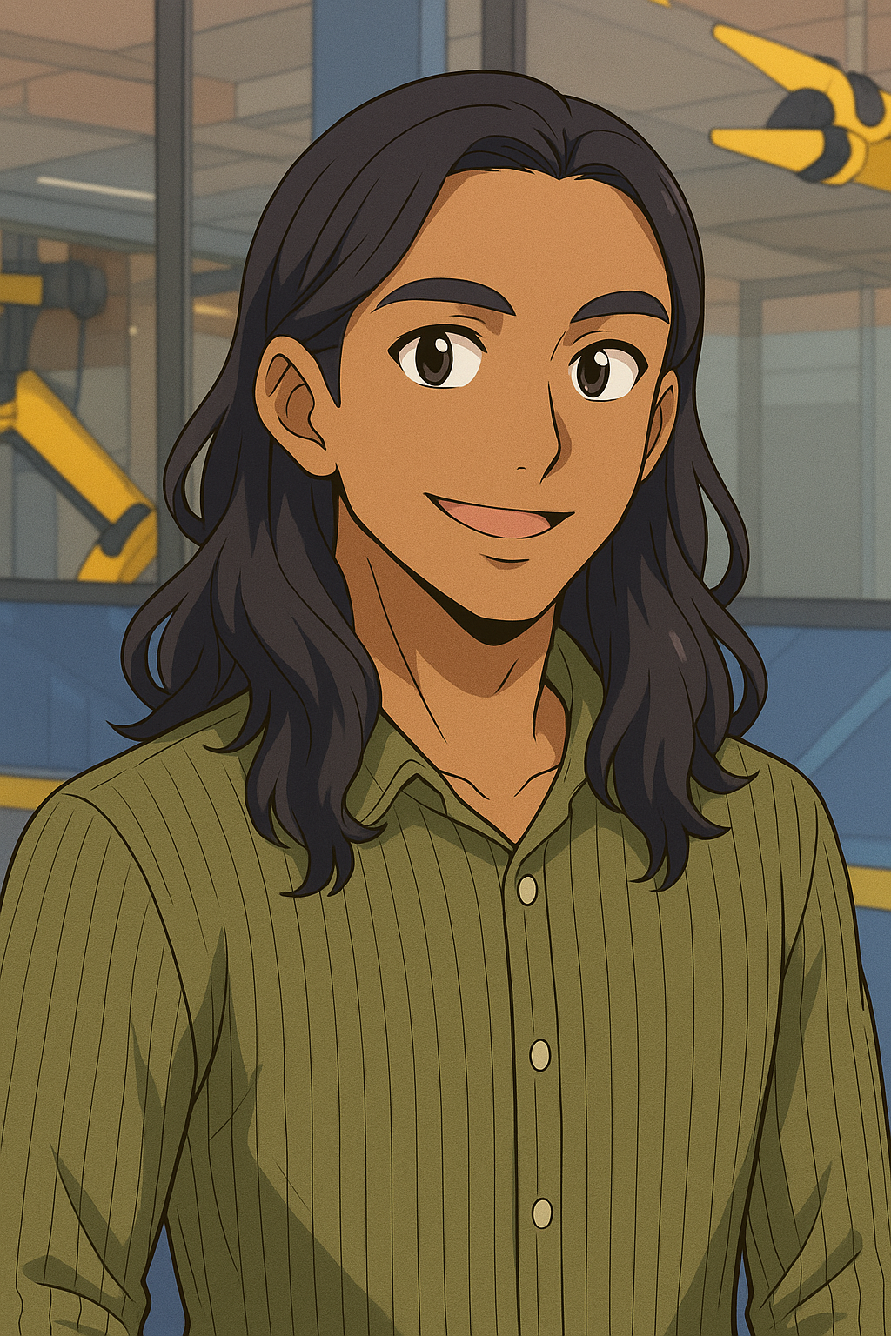
“The scariest thing about a triple backflip on the spot is probably
finding all the different ways that the hardware can fail
in these scenarios
and finding ways to mitigate them…”

Slide 5
Experiment to…
…gain a deep understanding.
“Customers don’t need this…”:
What can my robot do?
How does it work?
When does it fail?
How can we fix unexpected issues?
How can we make it robust/reliable?

Slide 6
“We need
a coordination system to chain all those behaviours together.
Our control software needs to know
how to move all the motors so Spot walks smoothly.
Our perception software needs to
understand information from the camera and allow Spot to navigate through a factory.”

Slide 7

“We need
a coordination system to chain all those behaviours together.
Our control software needs to know
how to move all the motors so Spot walks smoothly.
Our perception software needs to
understand information from the camera and allow Spot to navigate through a factory.”
3 Robotics Primitives:
PLAN
ACT
SENSE

Slide 8
“…sometimes they slip, sometimes they trip, and to recover, you need to exert a lot of power to reliably recover.
If our robots know how to fully utilise their hardware, we can make robots that are better at recovering…

Slide 9
Autonomous robots in unknown environments.
“Better” recovery, fault tolerance, reliable.
How could we argue that our system is “better?”
“…sometimes they slip, sometimes they trip, and to recover, you need to exert a lot of power to reliably recover.
If our robots know how to fully utilise their hardware, we can make robots that are better at recovering…

Slide 10
“It never works first time on the hardware.
It’s going to fail somehow. Anytime something fails,
we generate a log of everything that the robot observed during the failure.
Try to find why the robot failed. We fix that issue. Then we repeat the cycle.

Slide 11
Collecting evidence:
to debug
to investigate
to understand
A scientific process:
Observe → Predict → Test → Observe →

Slide 12
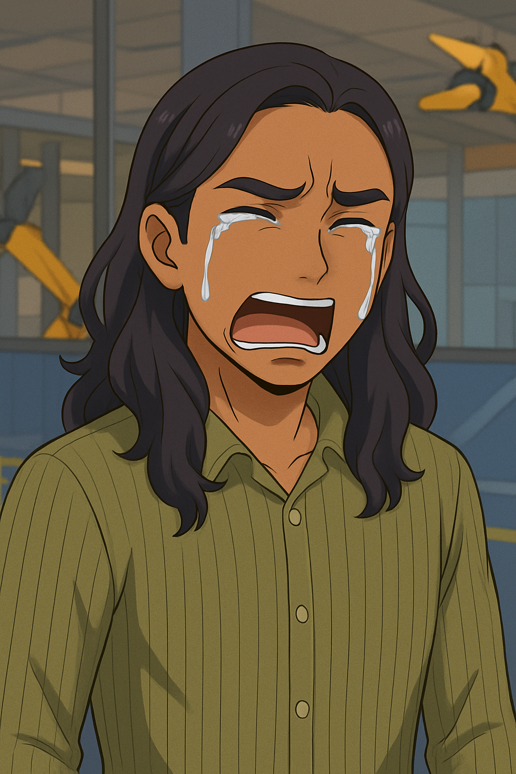
“Try to find why the robot failed. We fix that issue. Then we repeat the cycle.
Run it on hardware. Find the next failure. Debug it. Fix it. Run it on hardware.
And the more you do that, the more reliable your behaviours will be.

Slide 13
“Try to find why the robot failed. We fix that issue. Then we repeat the cycle.
Run it on hardware. Find the next failure. Debug it. Fix it. Run it on hardware.
And the more you do that, the more reliable your behaviours will be.
A simulation is never as good as reality.
Testing in reality requires time.
What matters is reliable, safe operation in reality.
We can reduce the time by thinking scientifically.
We need quantifiable evidence that our robots are safe.

Slide 14
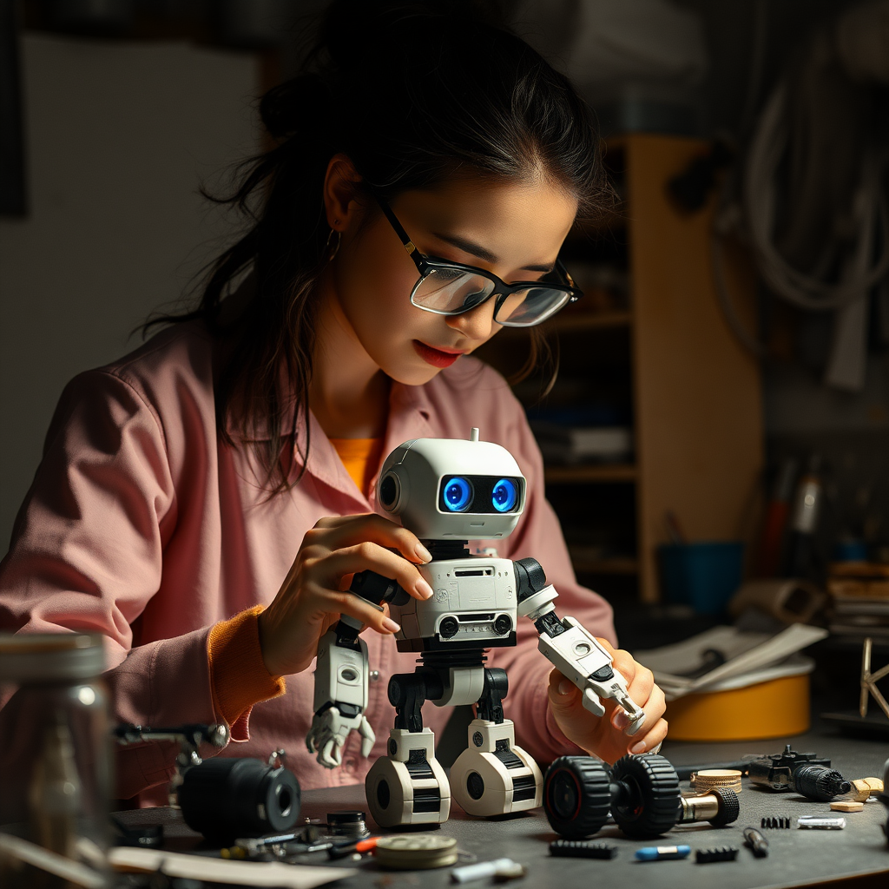

What do we want to learn? (core skills)
How to program and debug a robot.
How to read sensors (sense).
How to make autonomous decisions (plan).
How to operate motors (act).

Slide 15
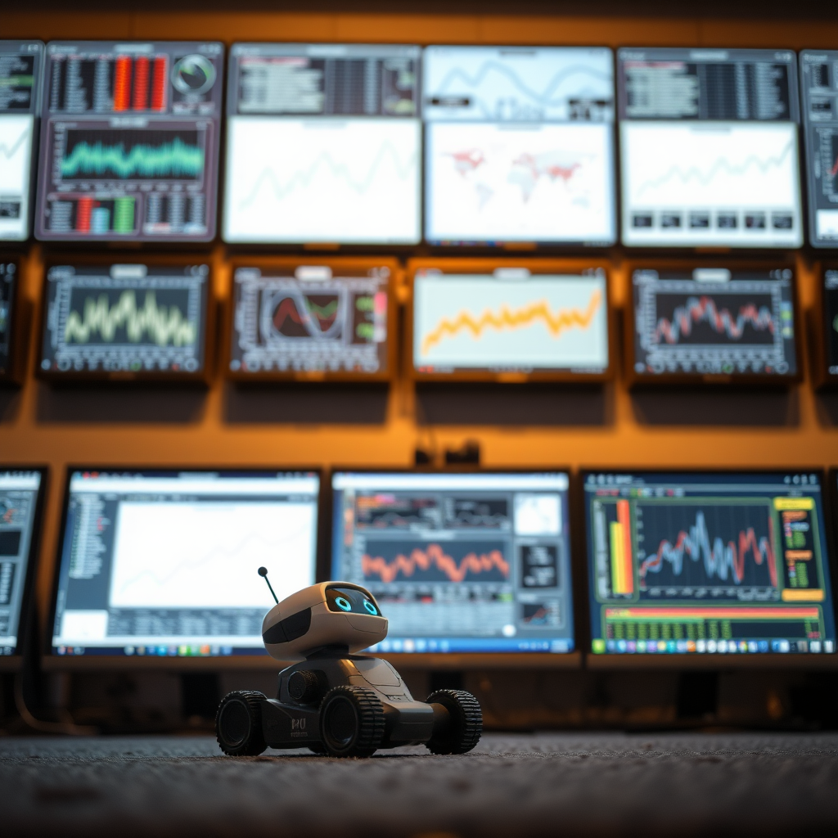
What do we want to learn? (advanced skills)
How to think scientifically / critical thinking.
Demonstrate our understanding.
Make a theory or prediction (hypothesis)
Take measurements, analyse evidence.
Make an argument.

Slide 16
How are we going to do this?
100% Coursework (Practical Study)
No Exam
Assessment 1
Coursework
Individual Basis
30%
Assessment 2
Coursework
Team Work / Group Work
2,3 or 4 students per Team
70%
Practical Lab Sessions
Period of Core Skill Development
“Solve a Problem”
Project Supervision
Period of Critical Thinking Skill Development
“Make a Scientific Argument”

Slide 17
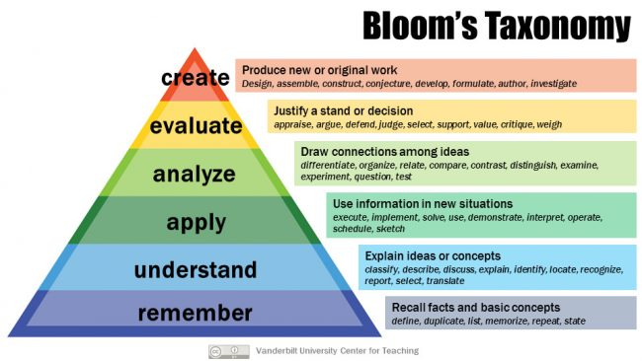
Expectation: Post-Graduate Study
Menti.com: 7400 8446
Ph.D
Post-Graduate
Undergraduate
Image from: Vanderbilt University Center for Teaching, https://cft.vanderbilt.edu/guides-sub-pages/blooms-taxonomy/
CC-SA License
http://www.bristol.ac.uk/academic-quality/assessment/regulations-and-code-of-practice-for-taught-programmes/marking-criteria/

Slide 18
Expectation: Post-Graduate Study
Menti.com: 7400 8446
Post-Graduate
Assessment 2
“Scientific Argument”
Undergraduate
Assessment 1
“Solve a Problem”
Image from: Vanderbilt University Center for Teaching, https://cft.vanderbilt.edu/guides-sub-pages/blooms-taxonomy/
CC-SA License
http://www.bristol.ac.uk/academic-quality/assessment/regulations-and-code-of-practice-for-taught-programmes/marking-criteria/

Slide 19
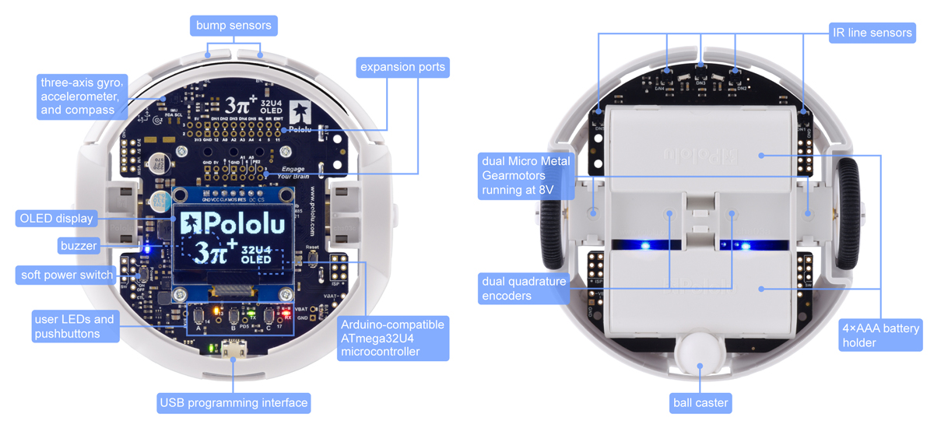
Pololu 3Pi+ Mobile Robot

Slide 20
In 11 weeks….

Slide 21
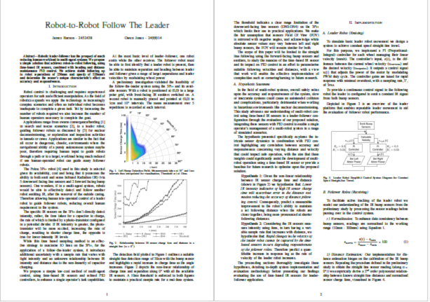
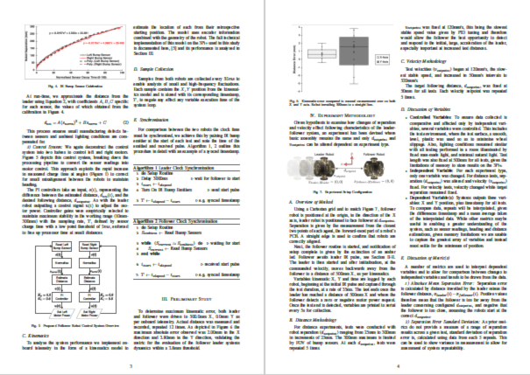
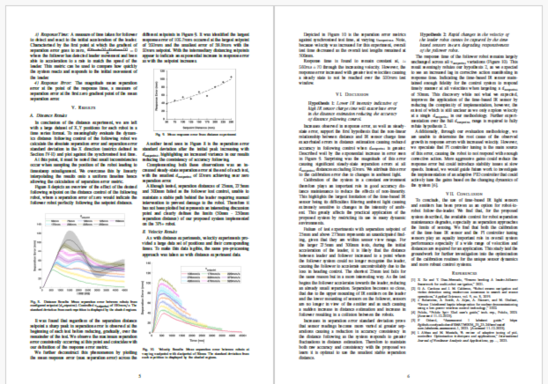

Assessment 2: 6 Page Conference Paper
How to evidence a contribution to knowledge.
Assessment 2 is Team Work: groups of 2,3 or 4 students.

Slide 22
Assessment 2: 6 Page Conference Paper
How to evidence a contribution to knowledge.
Describing a problem:
Value
Interest
Scope

Slide 23
Assessment 2: 6 Page Conference Paper
How to evidence a contribution to knowledge.
Implementation:
“How it was made”.
Reproducible
Rigorous

Slide 24
Assessment 2: 6 Page Conference Paper
How to report a contribution to knowledge.
Method:
How it was “measured”
Isolating the matter of interest
To capture credible data
Tools for analysis (metrics)

Slide 25
Assessment 2: 6 Page Conference Paper
How to evidence a contribution to knowledge.
Results:
What can be observed?
What is evidenced?
How confident can we be?

Slide 26
Assessment 2: 6 Page Conference Paper
How to evidence a contribution to knowledge.
Conclusions:
What was learnt?
What would be next?

Slide 27
Assessment 2: 6 Page Conference Paper
We need to learn how to use this robot first.
We need to understand how it operates.
Observations: investigate and evidence something interesting.

Slide 28
How are we going to do this?
100% Coursework (Practical Study)
No Exam
Assessment 1
Coursework
Individual Basis
30%
Assessment 2
Coursework
Team Work / Group Work
2,3 or 4 students per Team
70%
Practical Lab Sessions
Period of Core Skill Development
“Solve a Problem”
Project Supervision
Period of Critical Thinking Skill Development
“Make a Scientific Argument”

Slide 29
Timeline
Assessment 1 Deadline
1pm, Thursday 23rd October 2025
Assessment 2
Experiment/Report, Team work.
Summative Assessment, 70%
Teaching Block 1
Week Commencing:
22 Sep
29 Sep
6 Oct
13 Oct
20 Oct
27 Oct
3 Nov
10 Nov
17 Nov
24 Nov
1 Dec
8 Dec
W1
W2
W3
W4
W5
W6 CW
W7
W8
W9
W10
W11
W12
Assessment 1
Skill Building, Individual Work
Summative Assessment, 30%
Assessment 2 Deadline
1pm, Thursday 4th December 2025
WE ARE HERE

Slide 30
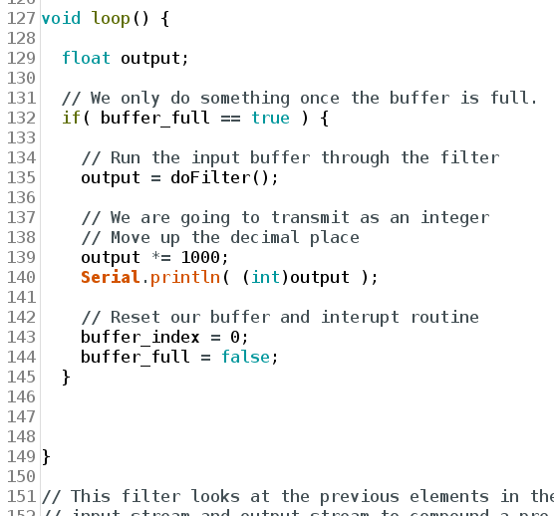
Timeline
Your Code
Assessment 2
Experiment/Report, Team work.
Summative Assessment, 70%
Teaching Block 1
Week Commencing:
22 Sep
29 Sep
6 Oct
13 Oct
20 Oct
27 Oct
3 Nov
10 Nov
17 Nov
24 Nov
1 Dec
8 Dec
W1
W2
W3
W4
W5
W6 CW
W7
W8
W9
W10
W11
W12
Assessment 1
Skill Building, Individual Work
Summative Assessment, 30%
WE ARE HERE

Slide 31
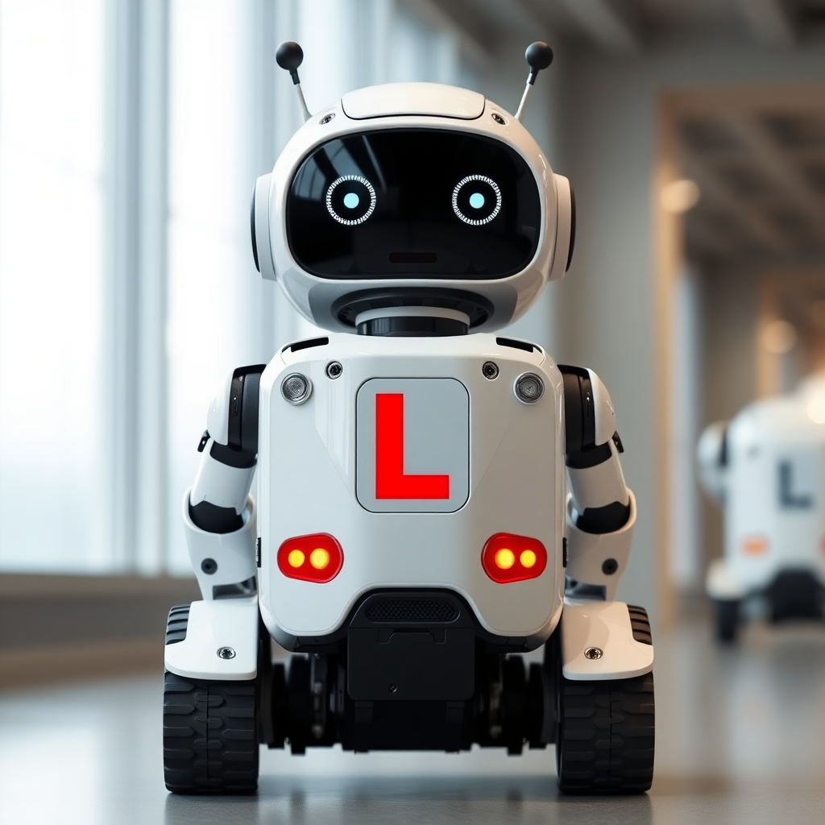
Timeline
Assessment 1 Deadline
1pm, Thursday 23rd October 2025
Teaching Block 1
Week Commencing:
22 Sep
29 Sep
6 Oct
13 Oct
20 Oct
27 Oct
3 Nov
10 Nov
17 Nov
24 Nov
1 Dec
8 Dec
W1
W2
W3
W4
W5
W6 CW
W7
W8
W9
W10
W11
W12
Assessment 1
Skill Building, Individual Work
Summative Assessment, 30%
Pass our driving test!
WE ARE HERE

Slide 32
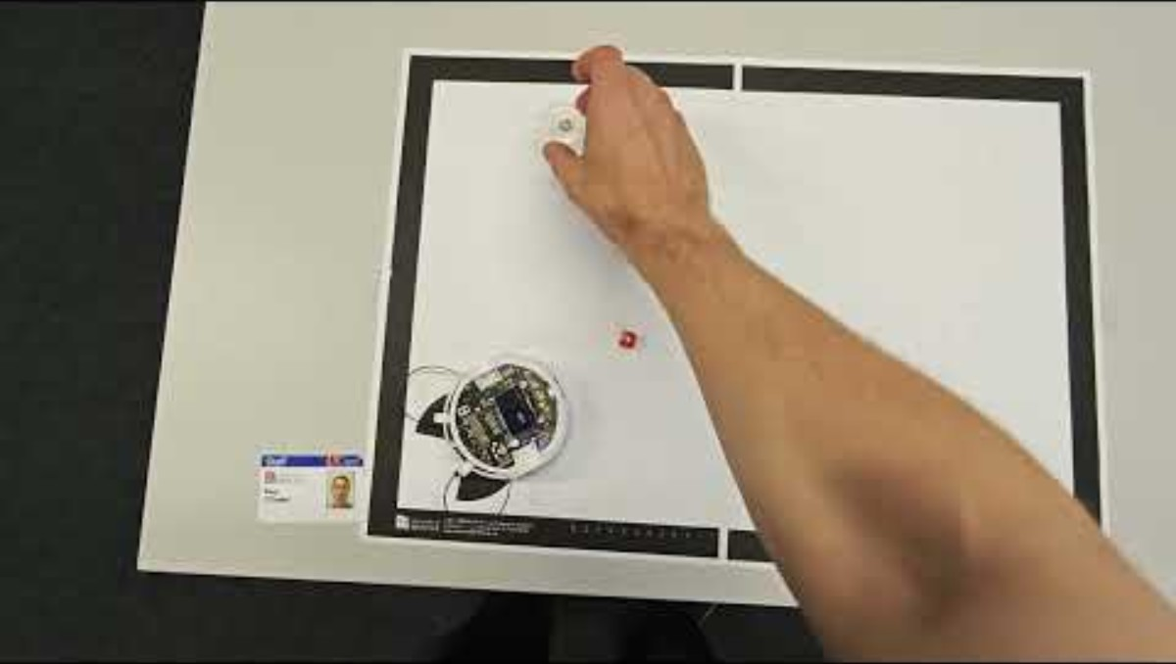
Assessment 1: Foraging Challenge (Expert)
Assessment 1 Deadline
1pm, Thursday 23rd October 2025
Record video
Complete an online self-assessment form
Upload your code to Blackboard
Mark: 70 – 100%

Slide 33
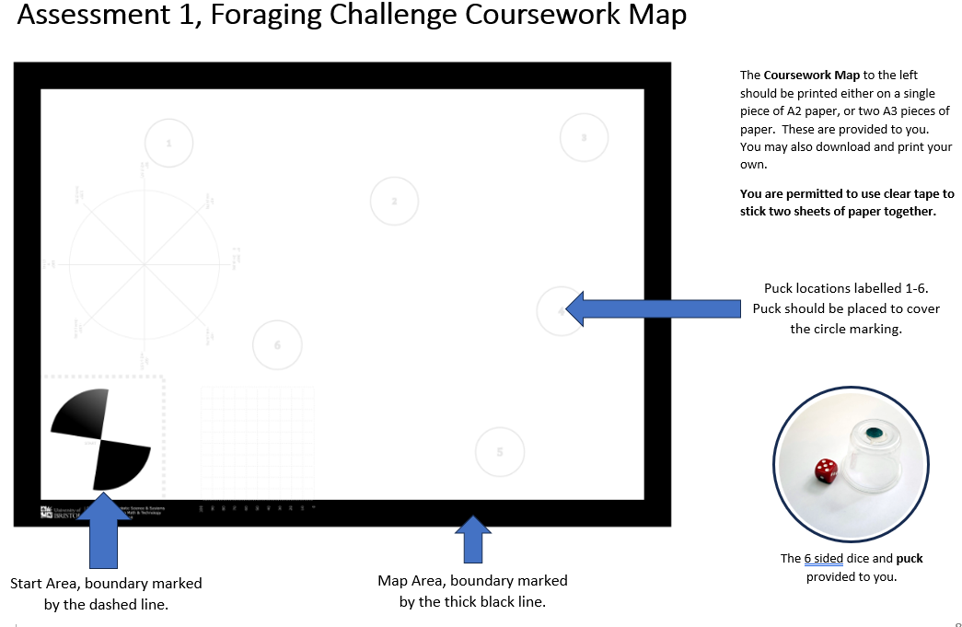
Assessment 1: Foraging Challenge

Slide 34
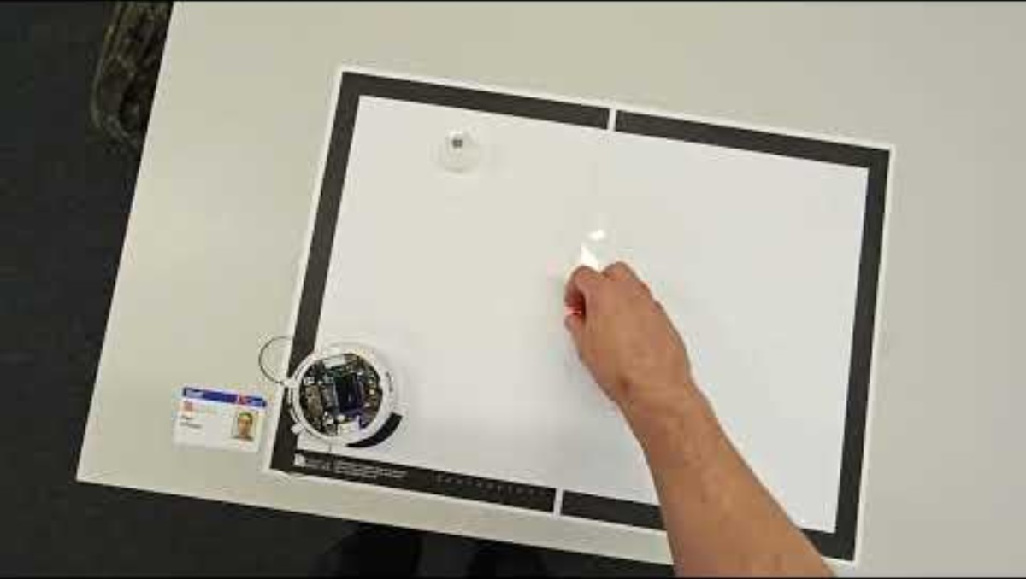
Assessment 1: Foraging Challenge (Intermediate)
Assessment 1 Deadline
1pm, Thursday 23rd October 2025
Record video
Complete an online self-assessment form
Upload your code to Blackboard
Mark: 60-68%

Slide 35
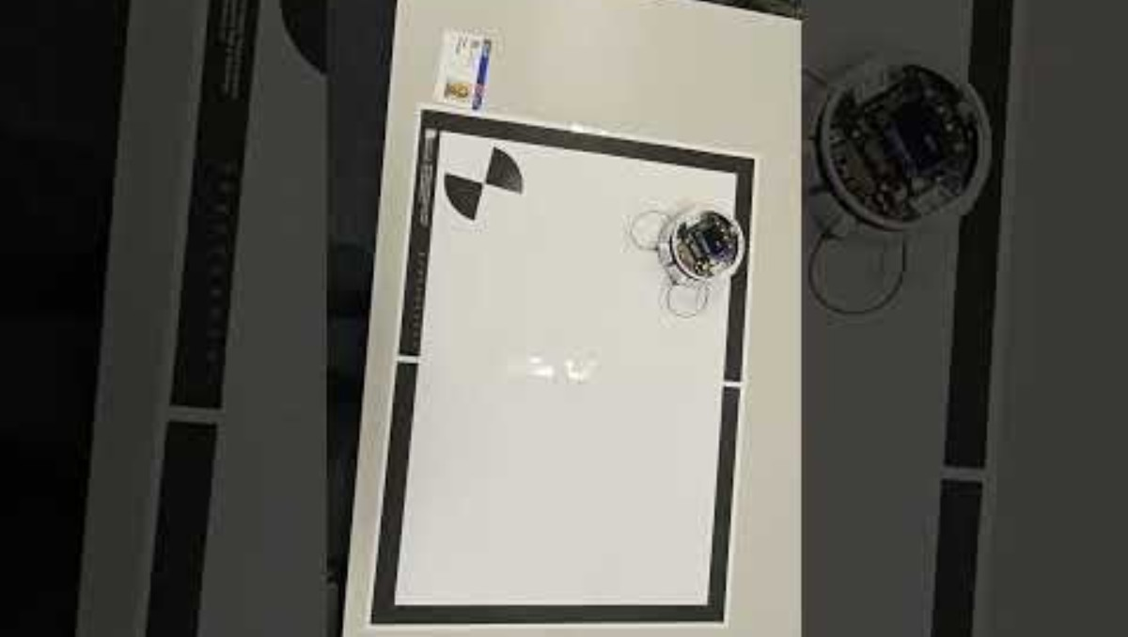
Assessment 1: Foraging Challenge (Beginner)
Assessment 1 Deadline
1pm, Thursday 23rd October 2025
Record video
Complete an online self-assessment form
Upload your code to Blackboard
Mark: 50 - 58%

Slide 36
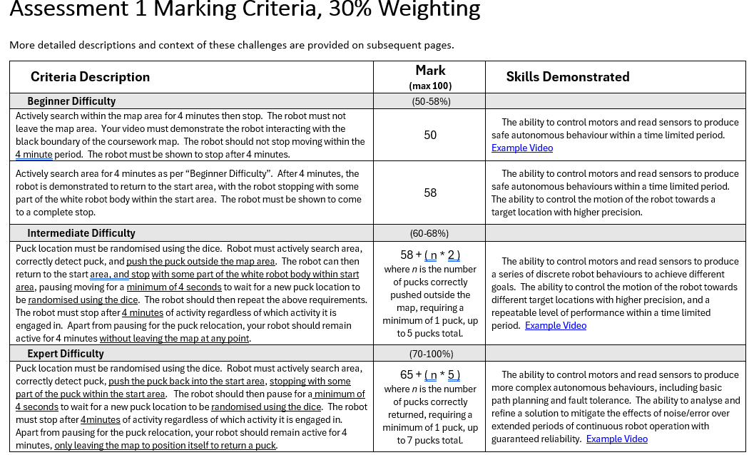
Assessment 1: Marking Criteria
PASS

Slide 37
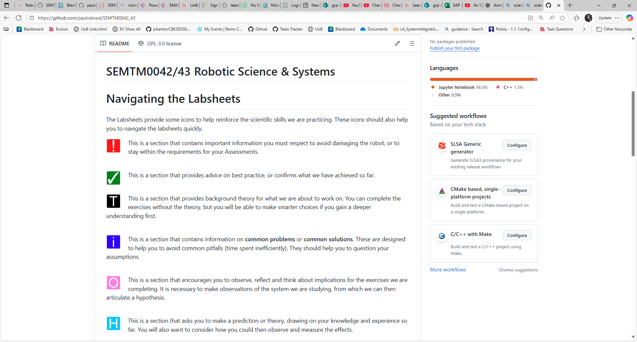
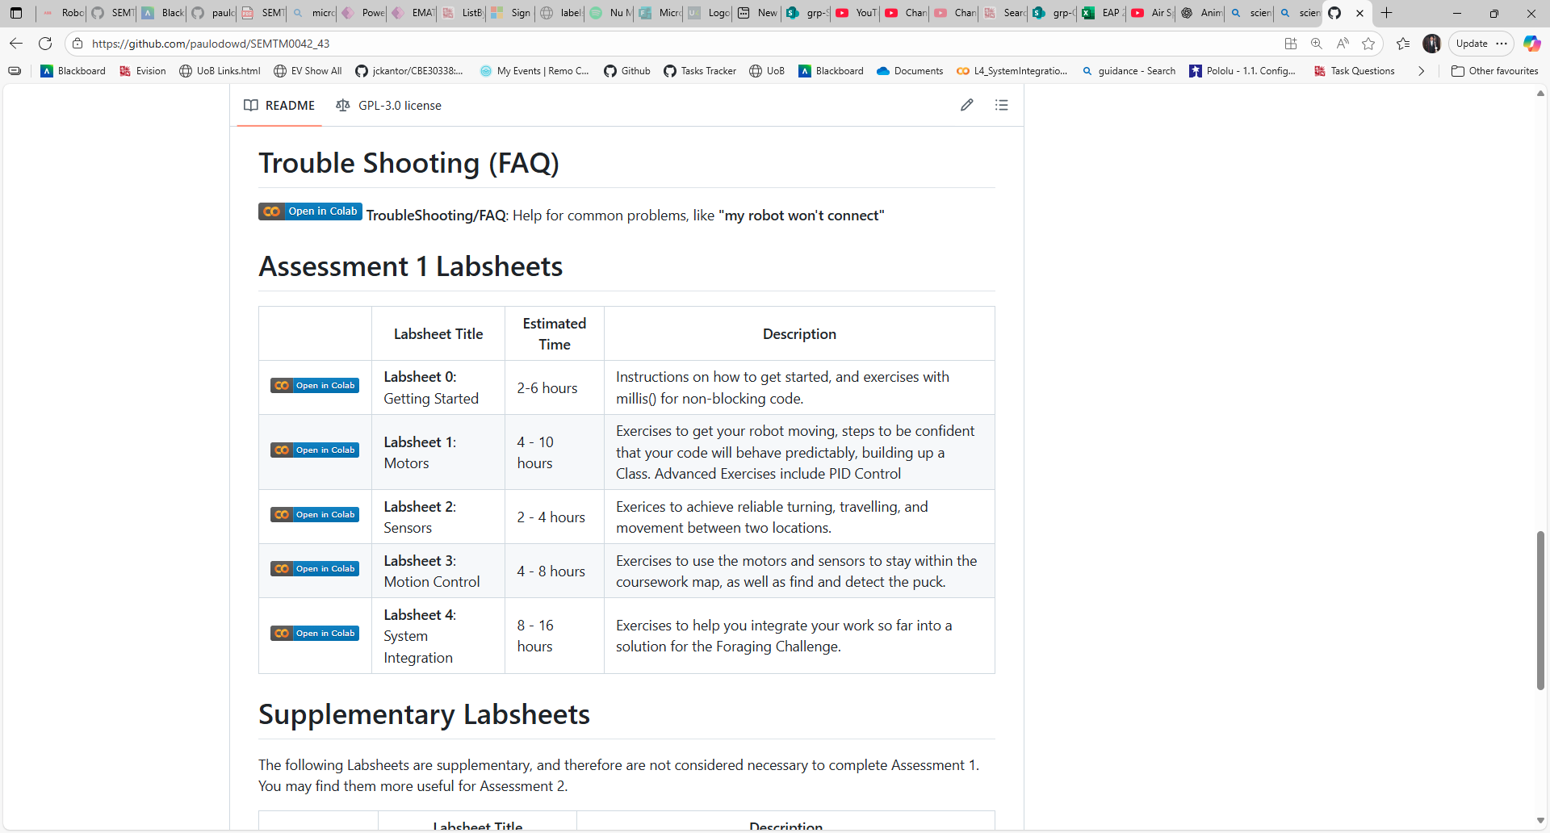
Labsheets

Slide 38
Labsheets
Labsheet 0:
Getting Started
Labsheet 1:
Motors
Labsheet 2:
Sensors
Beginner Difficulty
Labsheet 3:
Motion Control
Labsheet 4: System Integration
Intermediate Difficulty
Expert Difficulty

Slide 39
Labsheets
Labsheet 0:
Getting Started
Labsheet 1:
Motors
Labsheet 2:
Sensors
Beginner Difficulty
Labsheet 3:
Motion Control
Labsheet 4: System Integration
Intermediate Difficulty
Expert Difficulty

Slide 40


Recommended Approach:
Beginner
Intermediate
Expert

Slide 41
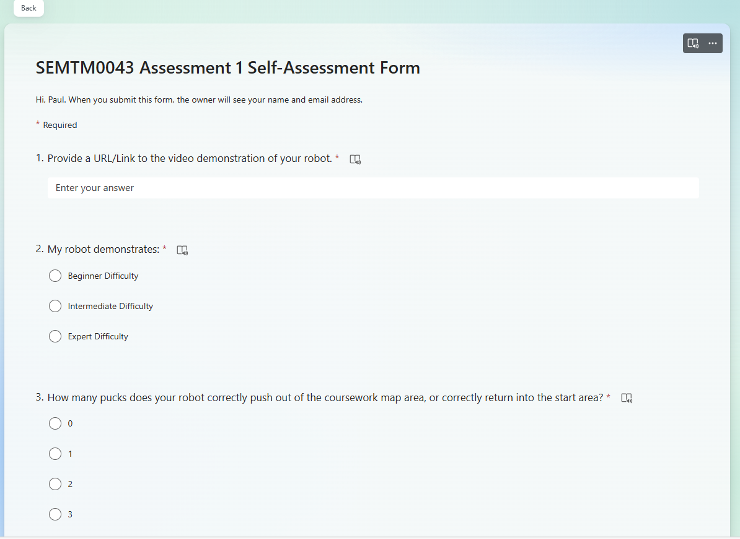
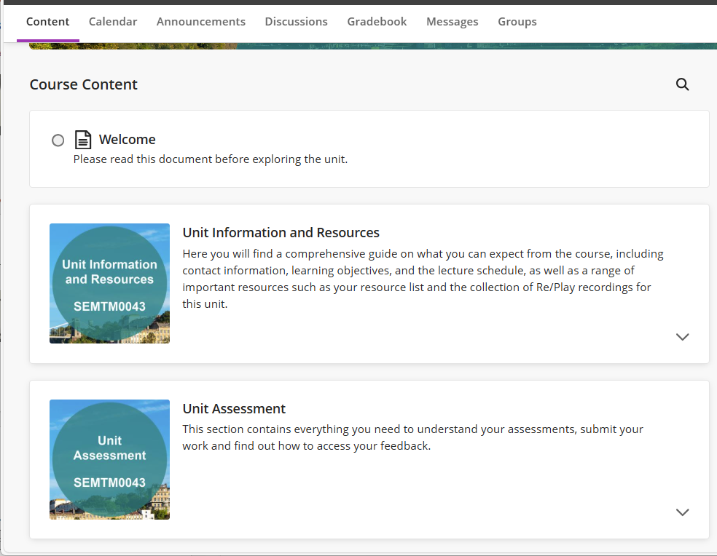
Assessment 1 Submission
Complete a Self-Assessment form:
Provide a URL/Link to a video:
Upload your final code to Blackboard:

Slide 42
Full-Time Study
Assessment 2
Experiment/Report, Team work.
Summative Assessment, 70%
Teaching Block 1
Week Commencing:
22 Sep
29 Sep
6 Oct
13 Oct
20 Oct
27 Oct
3 Nov
10 Nov
17 Nov
24 Nov
1 Dec
8 Dec
W1
W2
W3
W4
W5
W6 CW
W7
W8
W9
W10
W11
W12
Assessment 1
Skill Building, Individual Work
Summative Assessment, 30%
WE ARE HERE

Slide 43
Full-Time Study
Assessment 1 Deadline
1pm, Thursday 23rd October 2025
Teaching Block 1: Assessment 1
Week Commencing:
22 Sep
29 Sep
6 Oct
13 Oct
20 Oct
W1
W2
W3
W4
W5
2 Hour
Lab Session
Bill Brown Suite

Slide 44

Full-Time Study
Assessment 1 Deadline
1pm, Thursday 23rd October 2025
Teaching Block 1: Assessment 1
Week Commencing:
22 Sep
29 Sep
6 Oct
13 Oct
20 Oct
W1
W2
W3
W4
W5
8 Hours of Lab Session
8 Hours: If you only work in the 2 Hour Lab Sessions, you will probably not pass.

Slide 45
Full-Time Study
?
Assessment 1 Deadline
1pm, Thursday 23rd October 2025
Labsheet 0
Labsheet 1
Week Commencing:
22 Sep
29 Sep
6 Oct
13 Oct
20 Oct
W1
W2
W3
W4
W5
Per Week (16):
1 Hour lecture
13 Hours of independent study
2 Hour
Lab Session
Bill Brown Suite
SEMTM0043 20 Credits
20 Credits = 16 hours per week (approximately)

Slide 46
Full-Time Study
Assessment 1 Deadline
1pm, Thursday 23rd October 2025
Labsheet 0
Labsheet 1
Labsheet 2
Labsheet 3
Labsheet 3
Labsheet 4
Labsheet 4
Week Commencing:
22 Sep
29 Sep
6 Oct
13 Oct
20 Oct
W1
W2
W3
W4
W5
Assessment 1
79 Hours
4 Lab sessions
5 Labsheets
+ Problem solving
Assessment 2
Supervision Meeting 1

Slide 47
Plagiarism
Please read the Assessment Specification on Blackboard
If you use a GitHub repository (or similar) it must be set to private.
If someone uses your code – even without your knowing – it constitutes cheating, and academic offense.
Sharing your code solution with others is cheating, an academic offense. Accepting code from someone (inside or outside the university) is cheating, an academic offense.
Using code you find online, including software libraries, and copy-pasting library code, is considered plagiarism (claiming credit for another person’s work), an academic offense. The Labsheets specify the exact libraries you may use.
Assessment 1 is an Individual Assessment. You must produce your own, individual solution to the coursework. You may discuss solutions, but you must produce your own code solutions.
Code for Assessment 1 and Assessment 2 will be algorithmically checked for similarity against all other code submissions with the tool Sim_c (https://manpages.ubuntu.com/manpages/bionic/en/man1/sim_c++.1.html)
You are encouraged & supported to use the template code (3Pi_CodeStub) and the examples in the labsheets. These will be ignored when checking for code similarity.

Slide 48
Kit Hand-Out

Slide 49
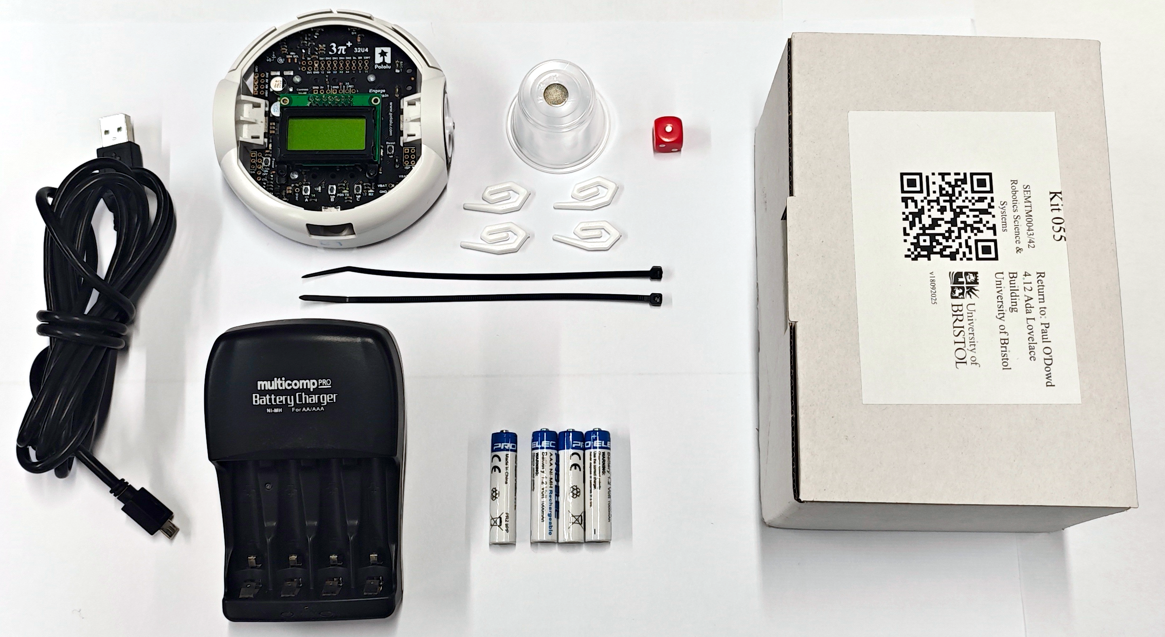
Your Robot Kit – Your Responsibility
On Loan for 11 Weeks:
You can take it home.
1 Box
Pololu 3Pi+ Robot
4 AAA Rechargable Batteries
Battery Recharger (UK)
2 Cable ties
4 Plastic Hooks
1 Puck with Magnet
1 USB cable
1 Dice
You are required to return all parts in week 11.
OLD
NEW

Slide 50
Your Robot – Common Damage
Stepping on the Robot.
This bends the wheel axles – permanent damage.
Do not leave your robot on the floor.
Operating the motors at high speed for a long time.
This causes the motors to over-heat – permanent damage.
When you need to debug your code, turn the battery power off.
Robot falling of a table.
Your robot might move suddenly and fall off the table. This bends the wheel axles – permanent damage.
You can lift the robot off the surface or turn it upside-down. Be careful.
“I cannot connect to my robot”
See the Troubleshooting labsheet

Slide 51
Risk Assessment
Please read the Risk Assessment on Blackboard
The robot is for your use – do not give it to children or other people.
Be aware of your surroundings.
Your robot may move suddenly. Avoid people tripping on your robot by ensuring you are in a safe environment. Tell others about what you are doing. As much as possible, keep your work in contained area.
Magnet:
The magnet is not a toy. Do not give it to children or allow children to find it. A magnet may cause problems for people with medical devices such as pace makers. Keep your magnet with your kit at all times.
+
Batteries:
Please ensure batteries are inserted into the charger in the correct orientation. Do not leave batteries to charge unattended or whilst you sleep.
-

Slide 52
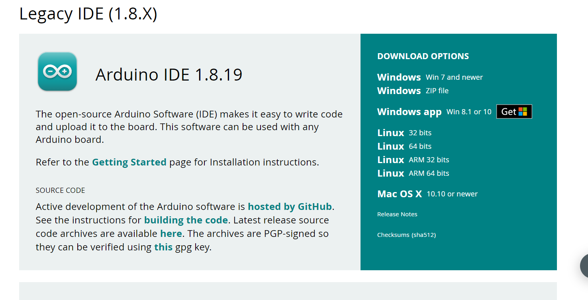
Arduino IDE
Getting Started: https://www.arduino.cc/en/software
OLD
Much more stable
NEW

Slide 53
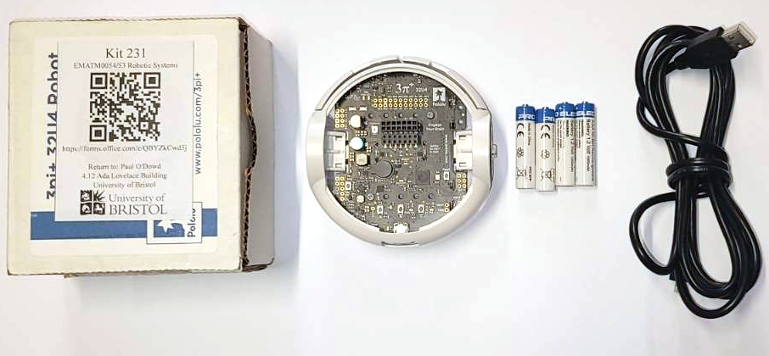
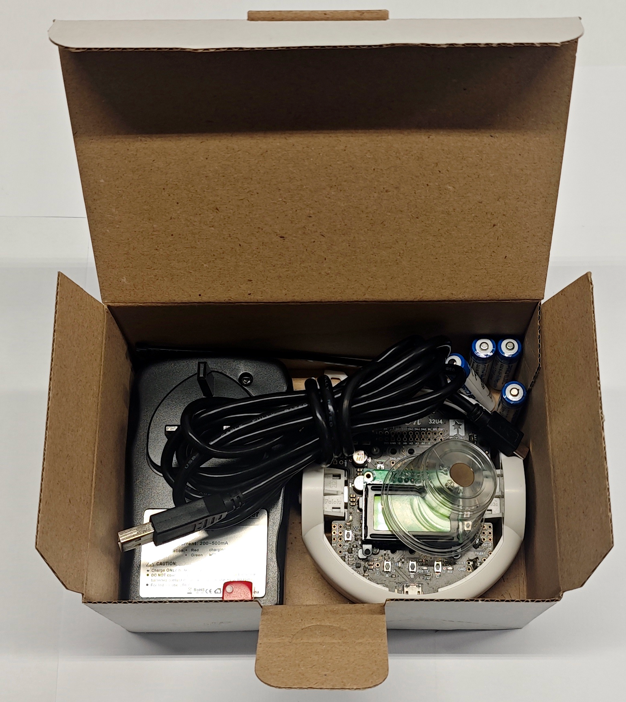
Kits
Problem with your Robot?
Keep the same Box.
OLD
SWAP
NEW

Slide 54
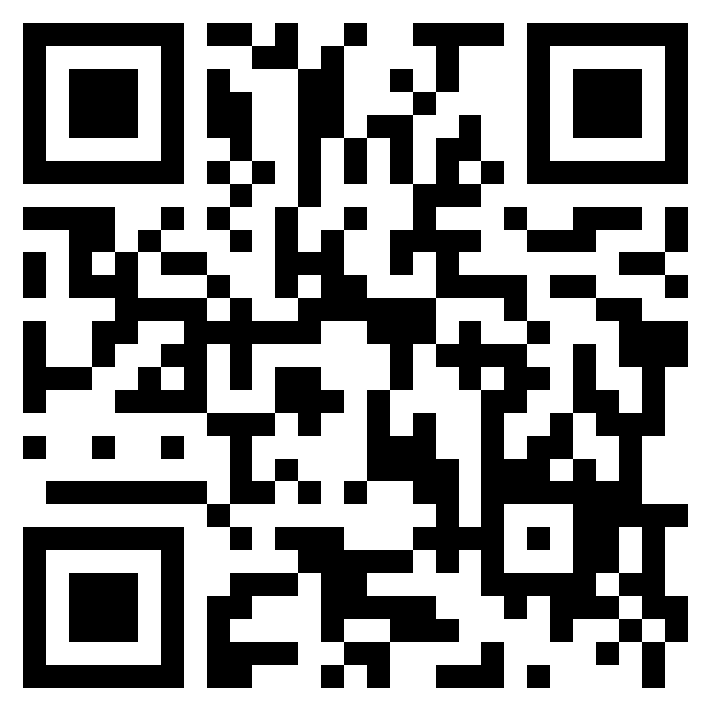
Kits
Use the QR Code to Register your Kit
Your Kit Number
Waiting?
Team Self-Allocation

